Slide 1
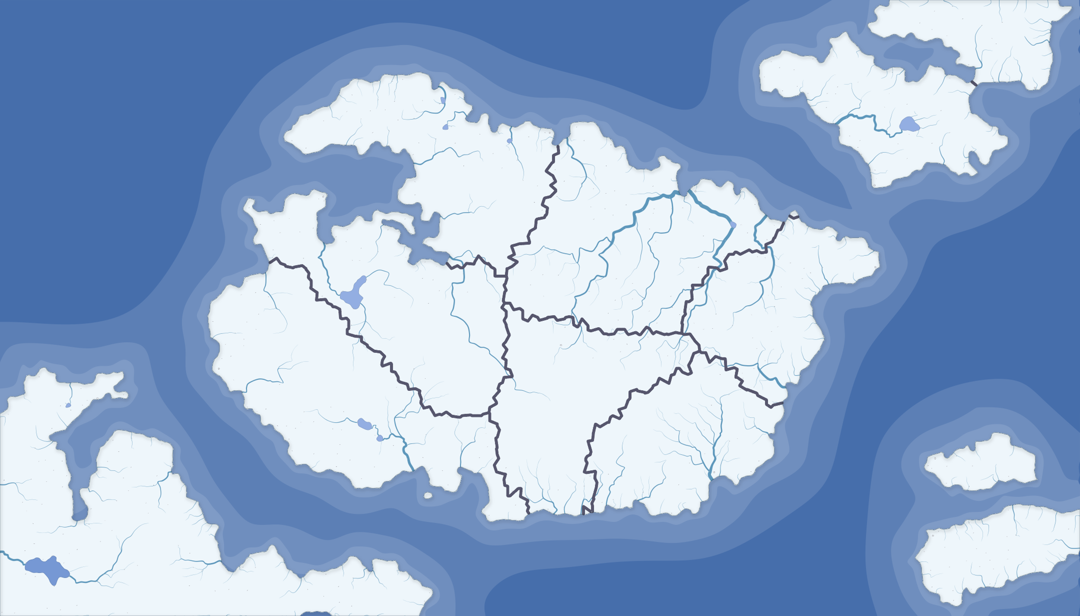
VLSI Continent
Quantum
Computing
Cryogenic
Ocean
Superconductive
Union
Synchronization
Physical
Design
Logic
synthesis
Device
Physics
Power
Delivery
Computer
Architecture
Circuit
Theory
Memristor
Island
Assembly Channel
Software
Empire
Nonvolatile
Sea
Spintronic
Island
Notes:
Speak here for 1 minute

Slide 2
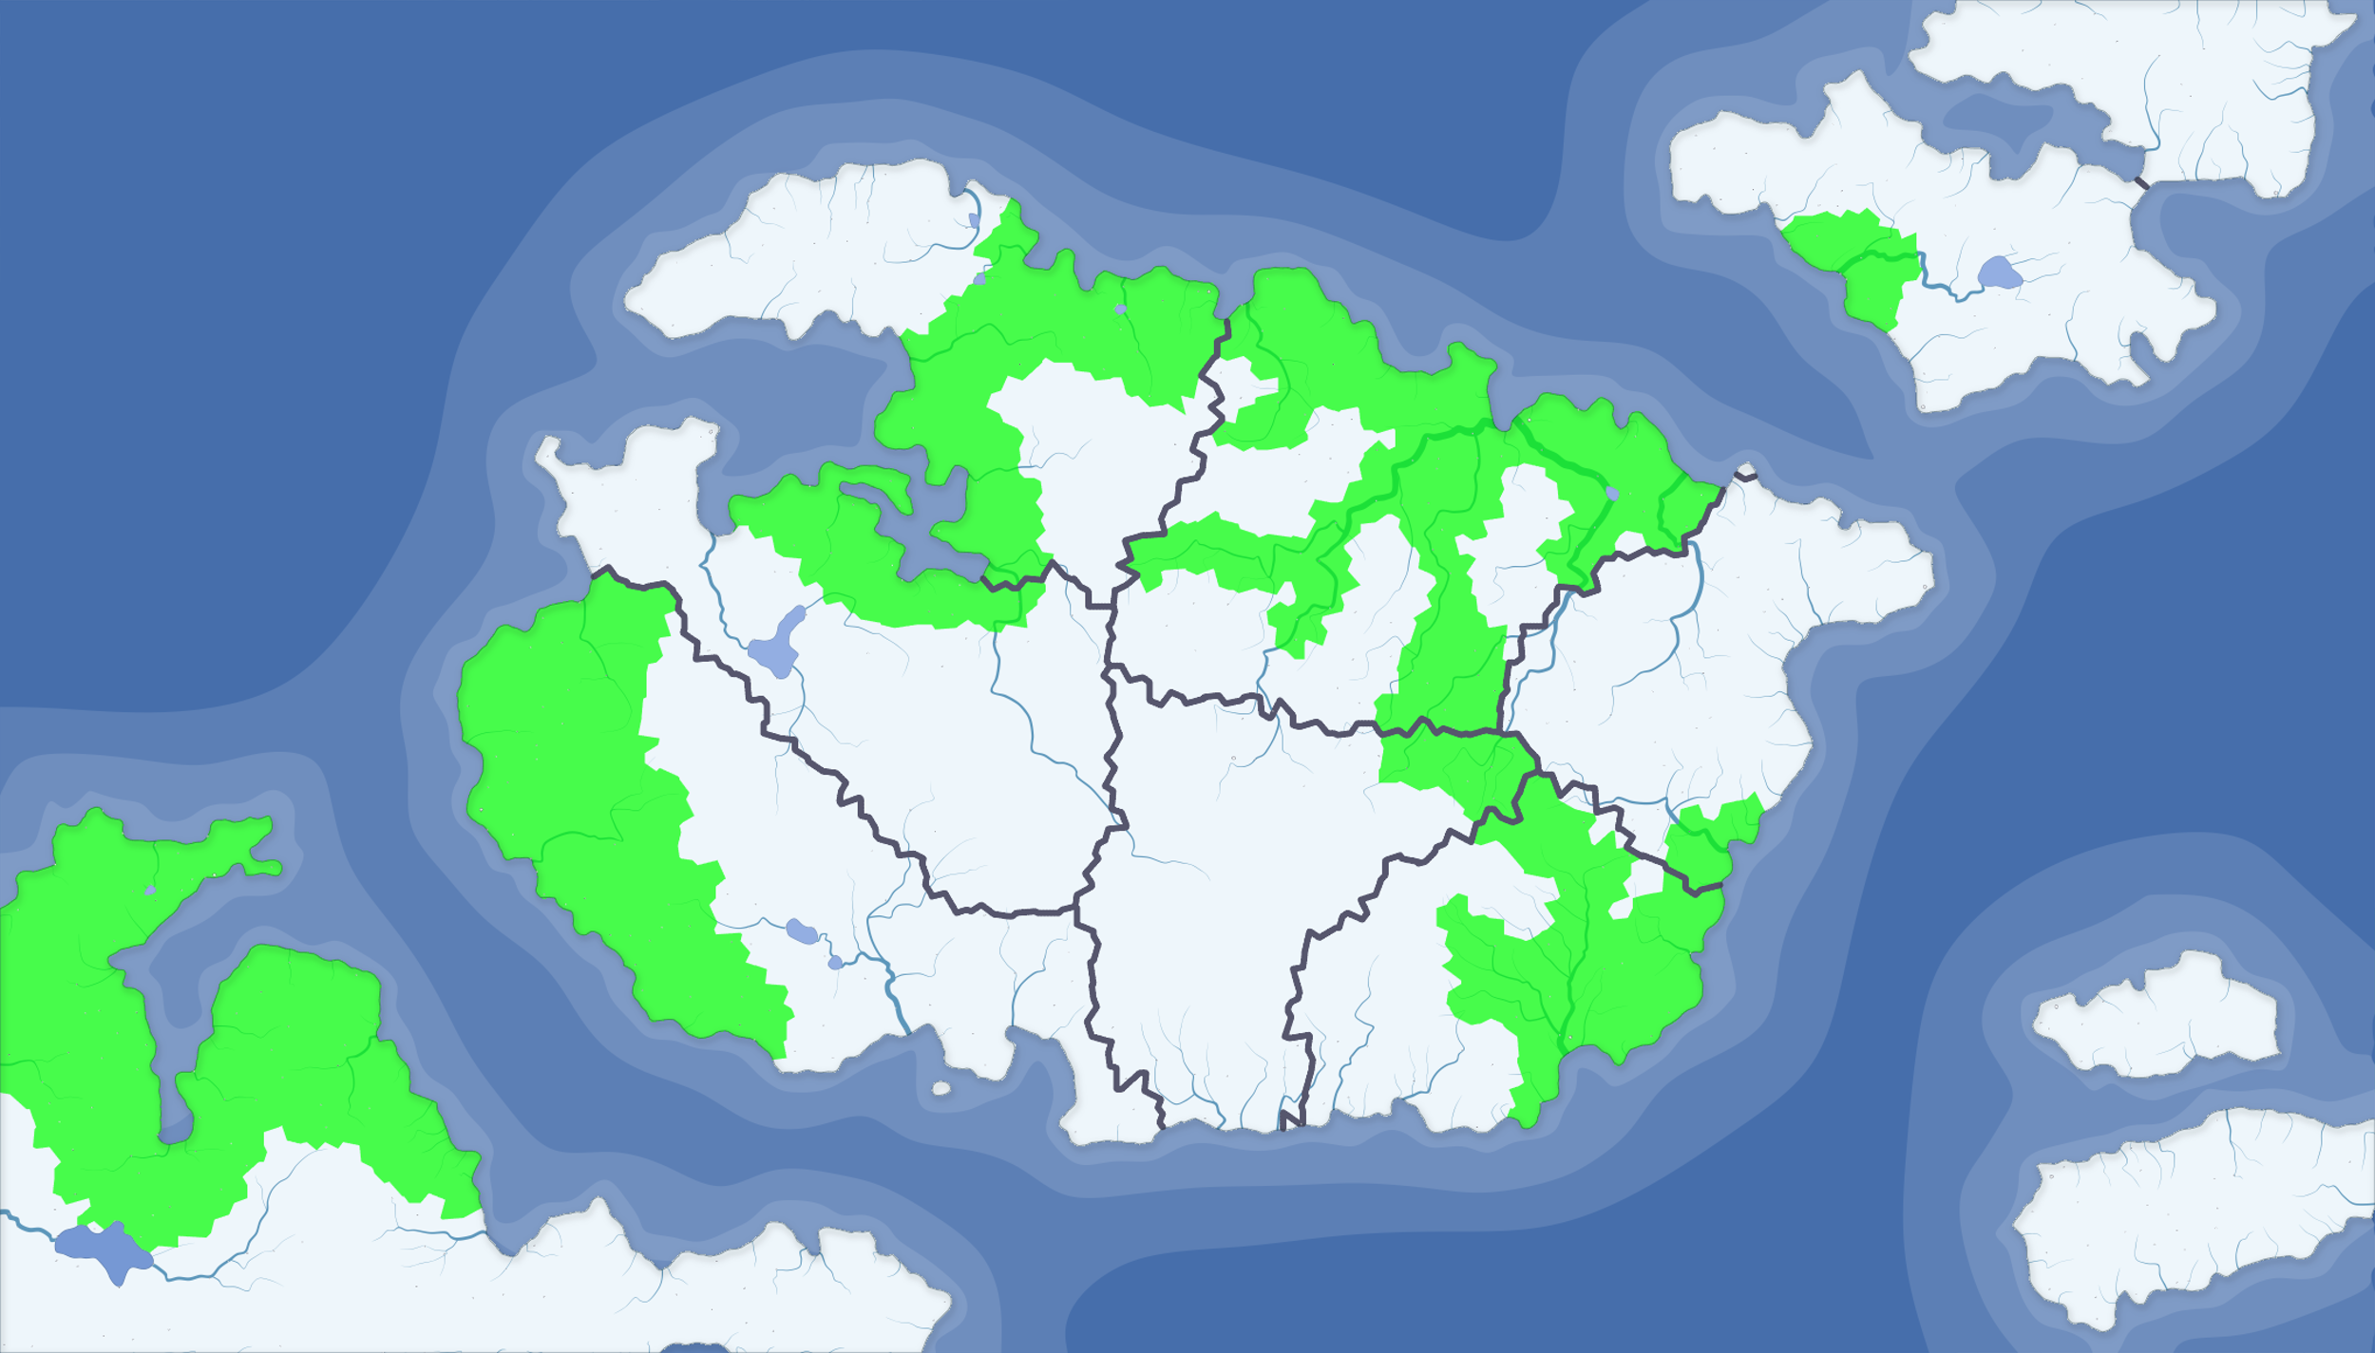
2017
VLSI Continent
Quantum
Computing
Cryogenic
Ocean
Superconductive
Union
Synchronization
Physical
Design
Logic
synthesis
Device
Physics
Power
Delivery
Computer
Architecture
Circuit
Theory
Memristor
Island
Assembly Channel
Software
Empire
Nonvolatile
Sea
Spintronic
Island

Slide 3
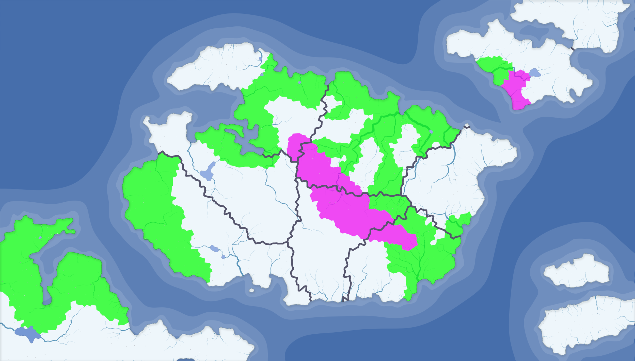
Research Effort
since 2017
VLSI Continent
Quantum
Computing
Cryogenic
Ocean
Superconductive
Union
Synchronization
Physical
Design
Logic
synthesis
Device
Physics
Power
Delivery
Computer
Architecture
Circuit
Theory
Memristor
Island
Assembly Channel
Software
Empire
Nonvolatile
Sea
Spintronic
Island

Slide 4
Research Effort
since 2017
VLSI Continent
Quantum
Computing
Cryogenic
Ocean
Superconductive
Union
Synchronization
Physical
Design
Logic
synthesis
Device
Physics
Effective Resistance
in Truncated and
Finite Grids
Power
Delivery
Computer
Architecture
Circuit
Theory
Memristor
Island
Assembly Channel
Software
Empire
Nonvolatile
Sea
Spintronic
Island

Slide 5
Research Effort
since 2017
VLSI Continent
Quantum
Computing
Cryogenic
Ocean
Superconductive
Union
Synchronization
Physical
Design
Logic
synthesis
Device
Physics
Power
Delivery
Exploratory
Methodology for
Power Delivery
Computer
Architecture
Circuit
Theory
Memristor
Island
Assembly Channel
Software
Empire
Nonvolatile
Sea
Spintronic
Island

Slide 6
Research Effort
since 2017
VLSI Continent
Quantum
Computing
Cryogenic
Ocean
Superconductive
Union
Synchronization
Placement of Distributed
On-Chip Voltage Regulators
Physical
Design
Logic
synthesis
Device
Physics
Power
Delivery
Computer
Architecture
Circuit
Theory
Memristor
Island
Assembly Channel
Software
Empire
Nonvolatile
Sea
Spintronic
Island

Slide 7
Research Effort
since 2017
VLSI Continent
Quantum
Computing
Cryogenic
Ocean
Superconductive
Union
Synchronization
Physical
Design
Logic
synthesis
Device
Physics
Power
Delivery
Computer
Architecture
SPROUT – Smart Power ROUTing Tool
for Power Network Prototyping
Circuit
Theory
Memristor
Island
Assembly Channel
Software
Empire
Nonvolatile
Sea
Spintronic
Island

Slide 8
Research Effort
since 2017
VLSI Continent
Quantum
Computing
Cryogenic
Ocean
QuCTS – Single Flux Quantum
Clock Tree Synthesis
Superconductive
Union
Synchronization
Physical
Design
Logic
synthesis
Device
Physics
Power
Delivery
Computer
Architecture
Circuit
Theory
Memristor
Island
Assembly Channel
Software
Empire
Nonvolatile
Sea
Spintronic
Island

Slide 9

Research Effort
since 2017
VLSI Continent
Quantum
Computing
Cryogenic
Ocean
Superconductive
Union
Synchronization
Physical
Design
Logic
synthesis
Device
Physics
Power
Delivery
Exploratory
Methodology for
Power Delivery
Computer
Architecture
Circuit
Theory
Memristor
Island
Assembly Channel
Software
Empire
Nonvolatile
Sea
Spintronic
Island

Slide 10
Research Effort
since 2017
VLSI Continent
Quantum
Computing
Cryogenic
Ocean
Superconductive
Union
Synchronization
Physical
Design
Logic
synthesis
Device
Physics
Power
Delivery
Computer
Architecture
SPROUT – Smart Power ROUTing Tool
for Power Network Prototyping
Circuit
Theory
Memristor
Island
Assembly Channel
Software
Empire
Nonvolatile
Sea
Spintronic
Island

Slide 11
Research Effort
since 2017
VLSI Continent
Quantum
Computing
Cryogenic
Ocean
Superconductive
Union
Synchronization
Physical
Design
Logic
synthesis
Device
Physics
Effective Resistance
in Truncated and
Finite Grids
Power
Delivery
Computer
Architecture
Circuit
Theory
Memristor
Island
Assembly Channel
Software
Empire
Nonvolatile
Sea
Spintronic
Island

Slide 12
Research Effort
since 2017
VLSI Continent
Quantum
Computing
Cryogenic
Ocean
Superconductive
Union
Synchronization
Physical
Design
QuCTS – Single Flux Quantum
Clock Tree Synthesis
Logic
synthesis
Device
Physics
Power
Delivery
Computer
Architecture
Circuit
Theory
Memristor
Island
Assembly Channel
Software
Empire
Nonvolatile
Sea
Spintronic
Island

Slide 13
Research Effort
since 2017
VLSI Continent
Quantum
Computing
Cryogenic
Ocean
Superconductive
Union
Synchronization
Physical
Design
Logic
synthesis
Device
Physics
Power
Delivery
Placement of Distributed
On-Chip Voltage Regulators
Computer
Architecture
Circuit
Theory
Memristor
Island
Assembly Channel
Software
Empire
Nonvolatile
Sea
Spintronic
Island

Slide 14
Research Effort
since 2017
VLSI Continent
Quantum
Computing
Cryogenic
Ocean
Superconductive
Union
Synchronization
Physical
Design
Logic
synthesis
Device
Physics
Power
Delivery
Computer
Architecture
Circuit
Theory
Memristor
Island
Assembly Channel
Software
Empire
Nonvolatile
Sea
Spintronic
Island

